Slide 2
Objectives Overview
Differentiate among a character, field, record, and data file and describe validation techniques
Differentiate between file processing systems and the database approach
Describe uses of web databases, types of databases, and Big Data
Discuss functions common to most database management systems: data dictionary, file retrieval and maintenance, data security, and backup and recovery
Define system development, list the system development phases, and identify the guidelines for system development
See Page 498
for Detailed Objectives

Slide 3
Objectives Overview
Discuss the importance of project management, feasibility assessment, documentation, and data and information gathering techniques
Discuss the purpose of and tasks conducted in each system development phase
Differentiate between low-level languages and procedural languages
Identify the benefits of object-oriented programming languages and application development tools
Describe various ways to develop webpages and web applications
See Page 498
for Detailed Objectives

Slide 4
Databases, Data, and Information
Database
Collection of data organized in a manner that allows access, retrieval, and use of that data
Data
Collection of unprocessed items
Text
Numbers
Images
Audio
Video
Information
Processed data
Organized
Meaningful
Useful
Page 498

Slide 5
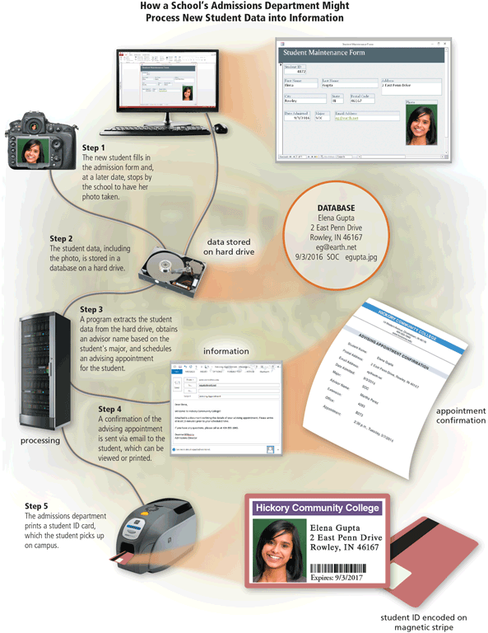
Databases, Data, and Information
Page 499
Figure 11-1

Slide 6
Databases, Data, and Information
Database software, often called a database management system (DBMS), allows users to:
Create a computerized database
Add, modify, and delete data
Sort and retrieve data
Create forms and reports from the data
Page 498

Slide 7
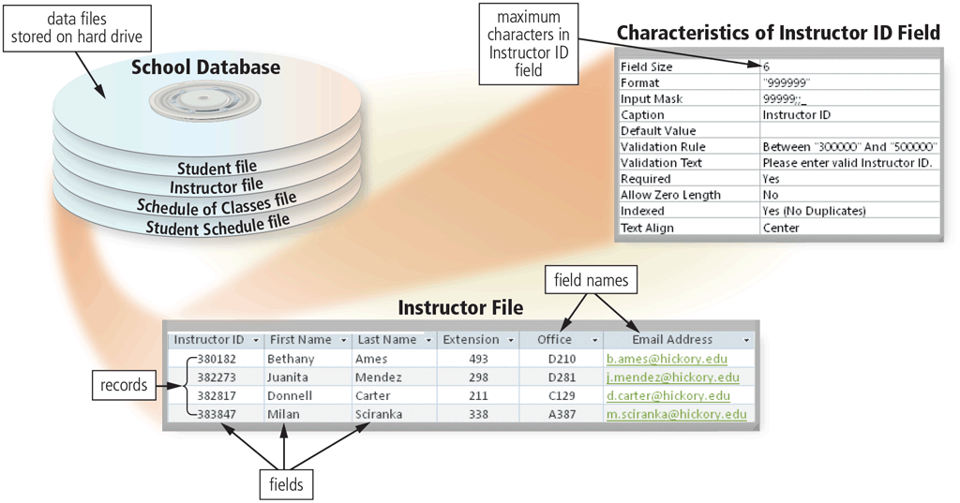
Databases, Data, and Information
Data is organized in levels
Characters, fields records, and files
Pages 500 - 501
Figure 11-2

Slide 8
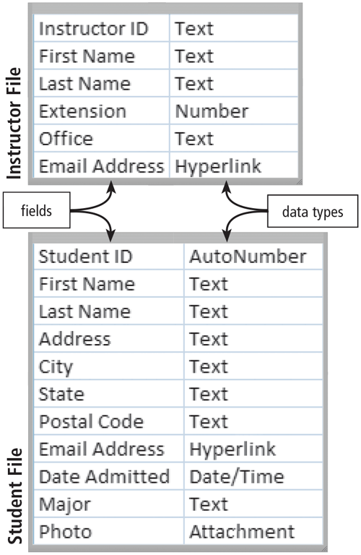
Databases, Data, and Information
A character is one byte
Numbers, letters, space, punctuation marks, or other symbols
A field is a combination of one or more related characters
Field name
Field size
Data type
Page 500
Figure 11-3

Slide 9
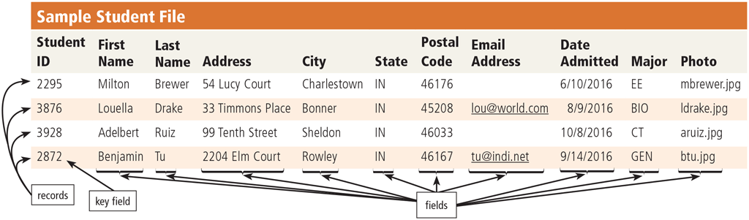
Databases, Data, and Information
A record is a group of related fields
A primary key is a field that uniquely identifies each record
A data file is a collection of related records
Page 501
Figure 11-4

Slide 10
Databases, Data, and Information
File maintenance refers to the procedures that keep data current
Adding records
Modifying records
Deleting records
Page 502

Slide 11
Databases, Data, and Information
Validation compares data with a set of rules or values to find out if the data meets certain criteria
Alphabetic/Numeric check
Range check
Consistency check
Completeness check
Check digit
Other checks
Page 503

Slide 12
File Processing Systems and Databases
File processing system
Database approach
Each department has its own set of files
Redundant data
Isolated data
Programs and users share data
Reduced data redundancy
Improved data integrity
Shared data
Easier access
Reduced development time
Pages 504 - 506

Slide 13
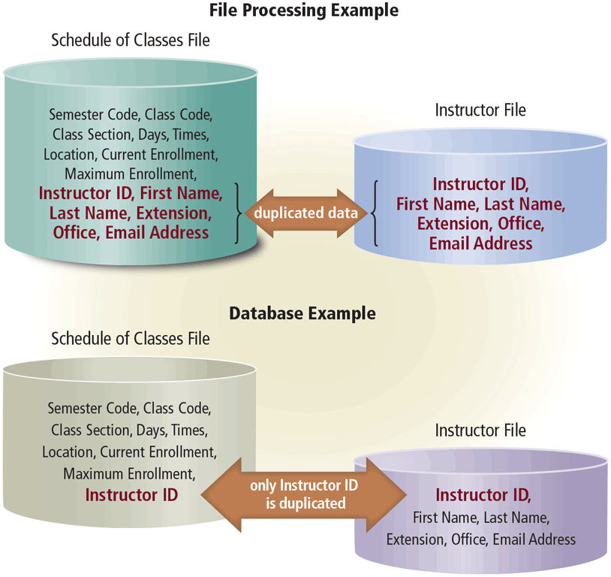
File Processing Systems and Databases
Page 505
Figure 11-6

Slide 14
File Processing Systems and Databases
Disadvantages of a database approach
Can be more complex than a file processing system
Require more memory and processing power
Data can be more vulnerable
Page 506

Slide 15
File Processing Systems and Databases
Web databases offer information about:
Jobs
Destinations
Television programming
Photos
Movies
Videos
Local and national weather
Sporting events
Legislative information
Travel
Page 506

Slide 16
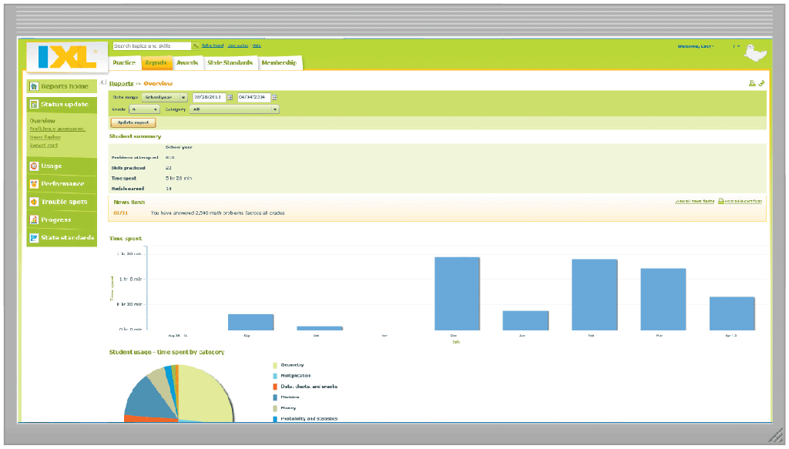
File Processing Systems and Databases
Page 507

Slide 17
File Processing Systems and Databases
A data model defines how users view the organization of the data
Relational database
Object-oriented database (OODB)
Multidimensional and other database types
Page 508

Slide 18
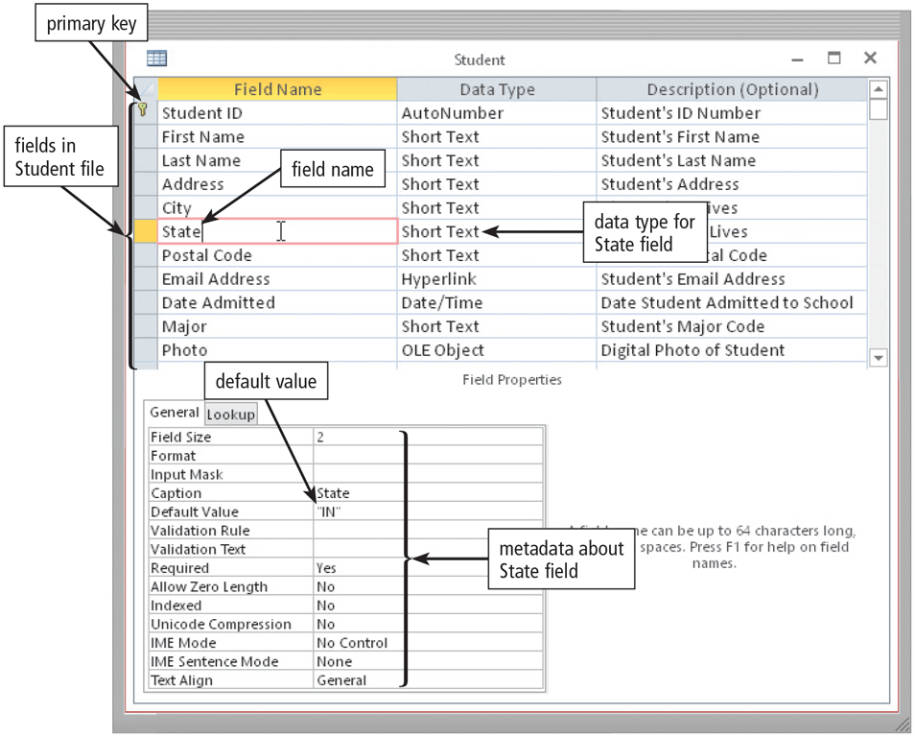
Database Management Systems
A data dictionary contains data about each file in the database and each field in those files
Page 510
Figure 11-7

Slide 19
Database Management Systems
A DBMS provides several tools that allow users and programs to retrieve and maintain data in the database
Query language
Query by example
Form
Report writer
Page 511

Slide 20
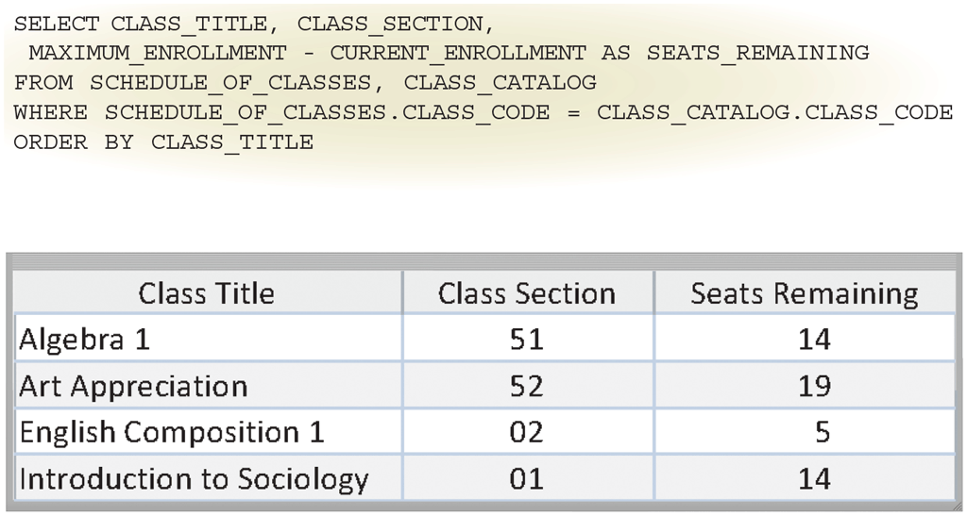
Database Management Systems
A query is a request for specific data from the database
A query language consists of simple, English-like statements that allow users to specify the data to display, print, store, update, or delete
Structured Query Language (SQL) is a popular query language that allows users to manage, update, and retrieve data
Pages 511 - 512

Slide 21
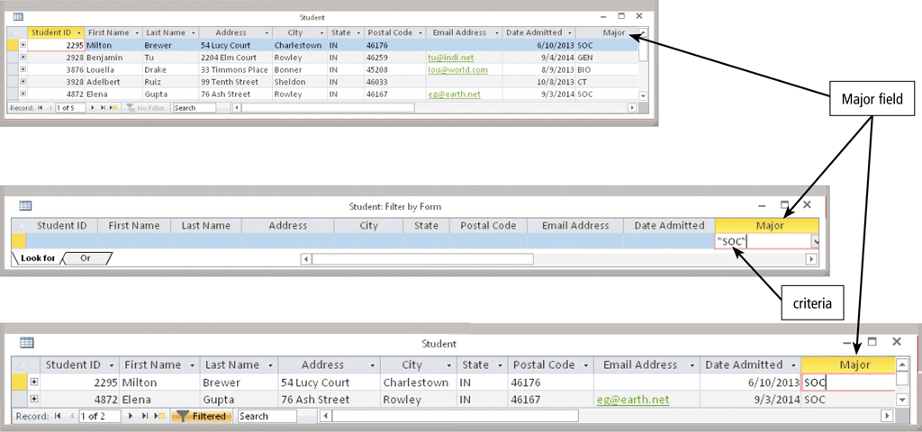
Database Management Systems
Most DBMSs include query by example (QBE), a feature that has a graphical user interface to assist users with retrieving data
Page 512
Figure 11-9

Slide 22
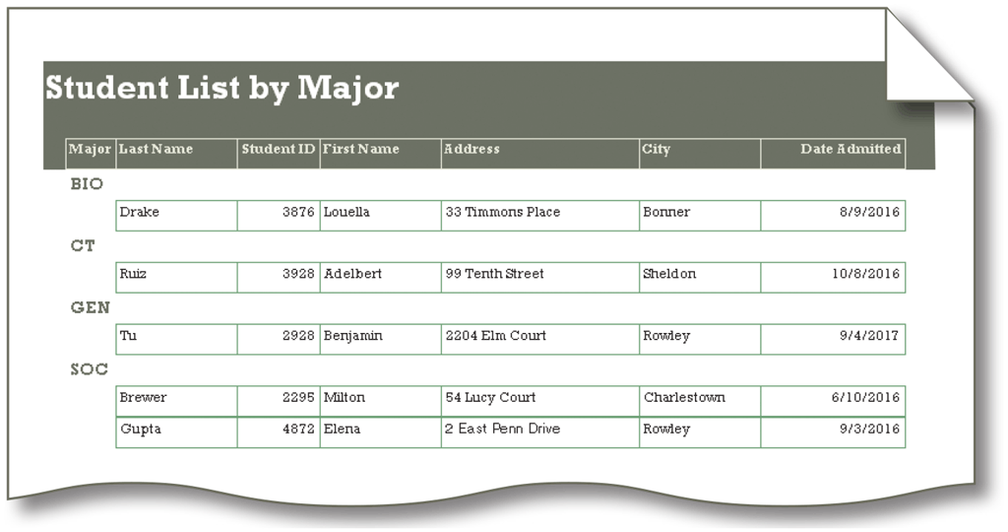
Database Management Systems
A form is a window on the screen that provides areas for entering or modifying data in a database
A report writer allows users to design a report on the screen, retrieve data into the report design, and then display or print the report
Pages 512 - 513
Figure 11-10

Slide 23
Database Management Systems
A DBMS provides means to ensure that only authorized users access data
Access privileges
Principle of least privilege policy
Page 513

Slide 24
Database Management Systems
A DMBS provides a variety of techniques to restore the database to a usable form in case it is damaged or destroyed
Backup
Log
Recovery utility
Continuous backup
Page 515

Slide 25
System Development
An information system is a collection of hardware, software, data, people, and procedures that work together to produce information
System development is a set of activities used to build an information system
Page 515

Slide 26
System Development
System development is a set of activities used to build an information system
System development activities are grouped into phases, and is called the system development life cycle (SDLC)
Page 515

Slide 27
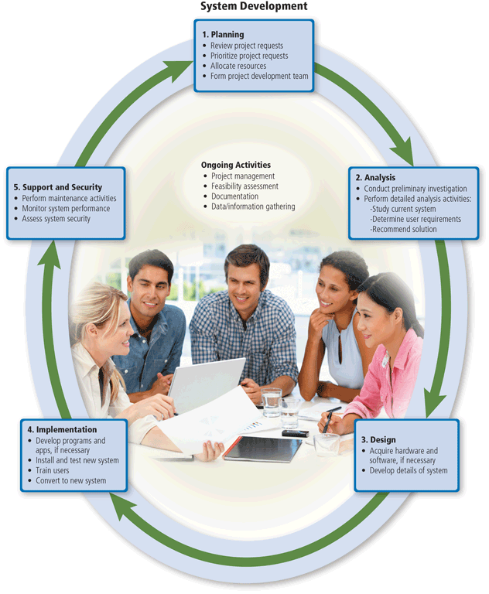
System Development
Page 516
Figure 11-11

Slide 28
System Development
System development should follow three general guidelines:
Group activities into phases
Involve users
Define standards
Page 517

Slide 29
System Development
System development should involve representatives from each department in which the proposed system will be used
A systems analyst is responsible for designing and developing an information system
Page 517

Slide 30
System Development
Project management is the process of planning, scheduling, and then controlling the activities during system development
To plan and schedule a project efficiently, the project leader identifies the following elements:
Scope
Required activities
Time estimates for each activity
Cost estimates for each activity
Order of activities
Activities that can take place at the same time
Page 517

Slide 31
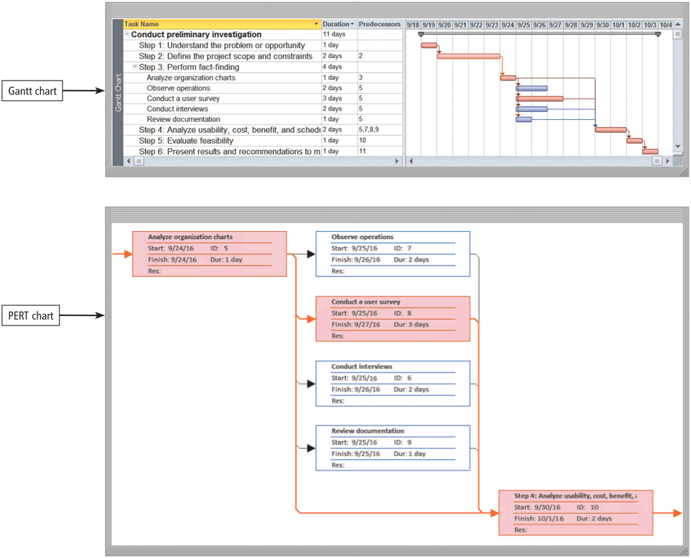
System Development
Popular tools used to plan and schedule the time relationships among project activities are Gantt and PERT charts
Page 518
Figure 11-12

Slide 32
System Development
Feasibility is a measure of how suitable the development of a system will be to the organization
Operational feasibility
Schedule feasibility
Technical feasibility
Economic feasibility
Page 519

Slide 33
System Development
Documentation is the collection and summarization of data, information, and deliverables
Maintaining up-to-date documentation should be an ongoing part of system development
Page 519

Slide 34

System Development
During system development, members of the project team gather data and information
Review documentation
Observe
Survey
Interview
JAD Sessions
Research
Page 520
Figure 11-13

Slide 35
System Development
The planning phase for a project begins when the steering committee receives a project request
Four major activities are performed:
Review and approve the project requests
Prioritize the project requests
Allocate resources
Form a project development team
Page 521

Slide 36
System Development
The analysis phase consists of two major activities:
Conduct a preliminary investigation
Perform detailed analysis
Determines the exact nature of the problem or improvement
Interview the user who submitted the request
Study how the current system works
Determine the users’ wants, needs, and requirements
Recommend a solution
Pages 521 - 522

Slide 37
System Development
The system proposal assesses the feasibility of each alternative solution
The steering committee discusses the system proposal and decides which alternative to pursue
Modify existing system
Buy retail software
Use web apps
Build custom software
Outsource
Page 522

Slide 38
System Development
The design phase consists of two major activities
Acquire hardware and software
Develop all of the details of the new or modified information system
Page 523

Slide 39
System Development
To acquire the necessary hardware and software:
Identify technical specifications
Solicit vendor proposals
Test and evaluate vendor proposals
Make a decision
Pages 523 - 524

Slide 40
System Development
The next step is to develop detailed design specifications
Database design
Input and output design
Program design
Page 524

Slide 41
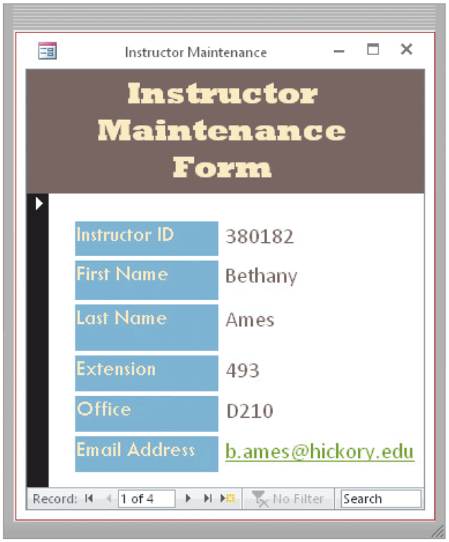
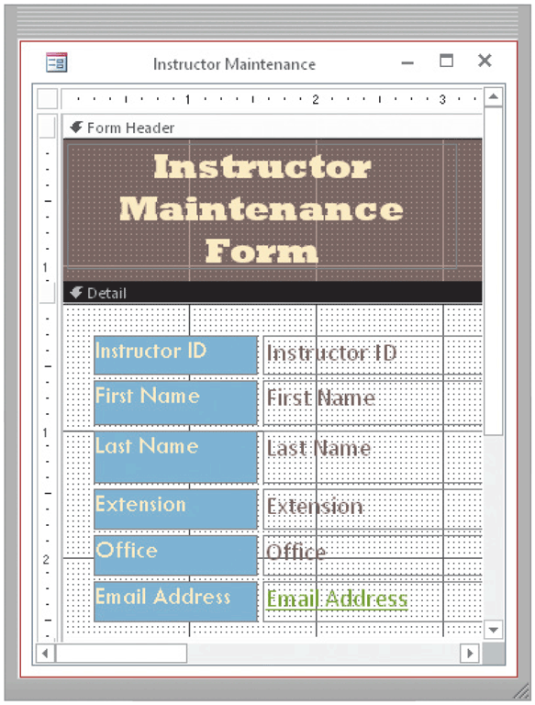
System Development
Systems analysts typically develop two types of designs for each input and output
Mock-up
Layout chart
Page 524
Figures 11-15 – 11-16

Slide 42
System Development
A prototype (proof of concept) is a working model of the proposed system’s essential functionality
Page 525

Slide 43
System Development
The purpose of the implementation phase is to construct the new or modified system and then deliver it to users
Develop programs and apps
Install and test the new system
Train users
Convert to the new system
Page 525

Slide 44
System Development
Various tests should be performed on the new system
Unit test
Verifies that each individual program or object works by itself
Systems test
Verifies that all programs in an application work together properly
Integration test
Verifies that an application works with other applications
Acceptance test
Checks the new system to ensure that it works with actual data
Page 525

Slide 45

System Development
Training involves showing users exactly how they will use the new hardware and software in the system
One-on-one sessions
Classroom-style lectures
Web-based training
Page 526
Figure 11-17

Slide 46
System Development
One or more of four conversion strategies can be used to change from the old system to the new system
Direct conversion
Parallel conversion
Phased conversion
Pilot conversion
Page 526

Slide 47
System Development
The purpose of the support and security phase is to provide ongoing assistance for an information system and its users after the system is implemented
Perform maintenance activities
Monitor system performance
Assess system security
Page 526

Slide 48
Application Development Languages and Tools
A programming language is a set of words, abbreviations, and symbols that enable a software developer to communicate instructions to a computer or mobile device
An application development tool provides a means for creating, designing, editing, testing, and distributing programs and apps
Page 527

Slide 49
Application Development Languages and Tools
Classification/programming paradigm:
Machine languages, that are interpreted directly in hardware
Assembly languages, that are thin wrappers over a corresponding machine language
High-level languages, that are anything machine-independent
Procedural languages: Fortran Pascal, C…,
Object-oriented programming (OOP) languages: Java, C++, C#, Python, PHP
Scripting languages, that are generally extremely high-level and powerful
Bash shell
Windows Powershell..
Query languages: SQL
Other languages: front-end, back-end, markup language… (HTML, XML, JSON, CSS, JavaScript, React…),
Page 527

Slide 50
Application Development Languages and Tools: procedural language
In a procedural language, the programmer writes instructions using English-like words that tell the computer what to accomplish and how to do it
Page 528

Slide 51
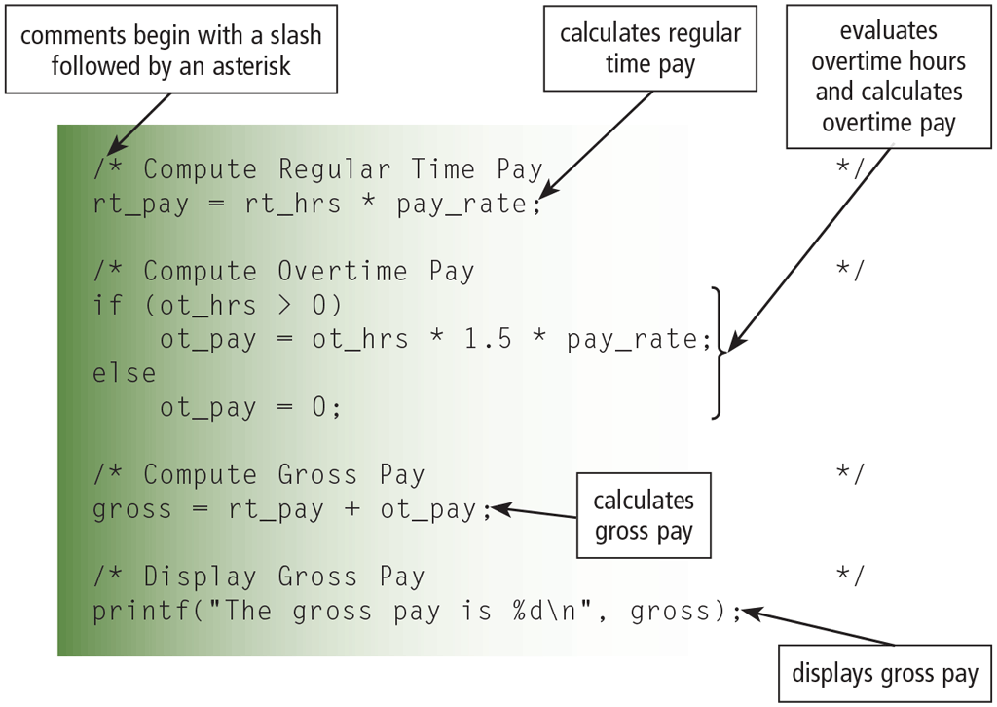
Application Development Languages and Tools: procedural language
The C programming language is used to write many of today’s programs
Page 528
Figure 11-18

Slide 52
Application Development Languages and Tools
A compiler converts the entire source program to machine language before executing it
An interpreter translates and executes one instruction at a time
Page 529

Slide 53
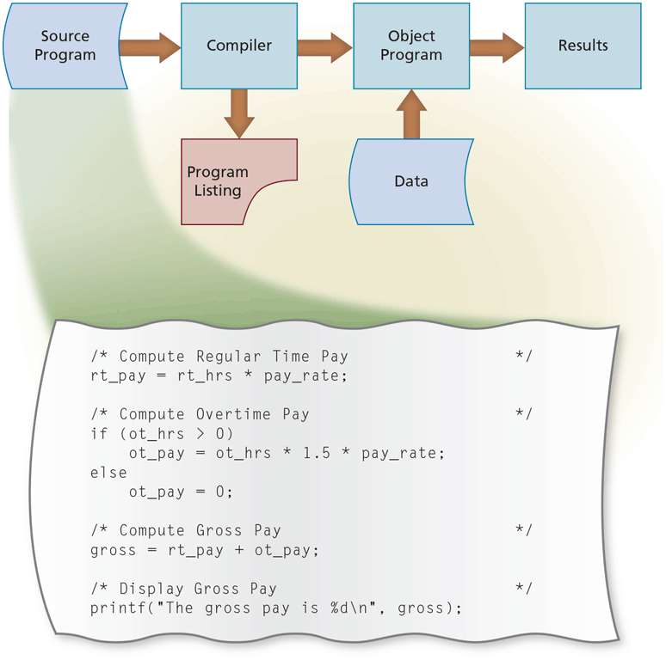
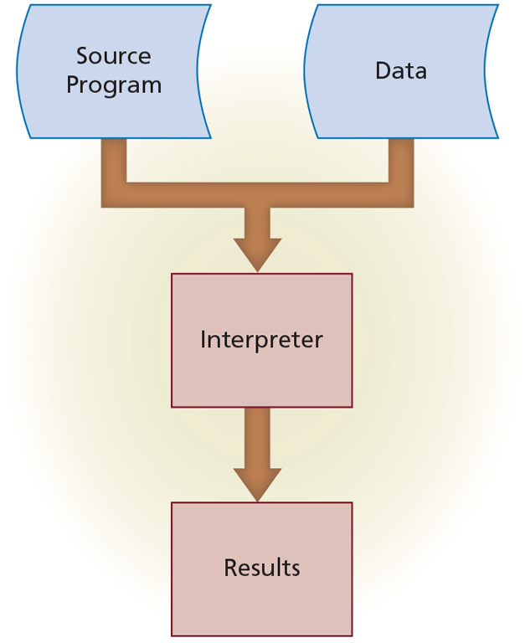
Application Development Languages and Tools
Compiler
Interpreter
Page 529
Figures 11-19 – 11-20

Slide 54
Application Development Languages and Tools: object-oriented programming language
An object-oriented programming (OOP) language allows system developers to implement objects in a program
Other advantages include:
Objects can be reused
Developers create applications faster
Most object-oriented application development tools are IDEs
Page 530

Slide 55
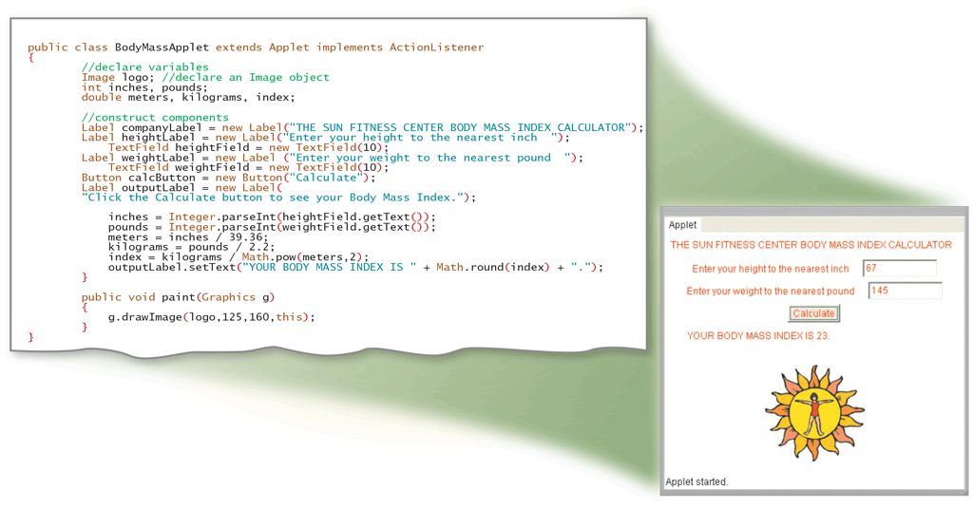
Application Development Languages and Tools: object-oriented programming language
Java is an object-oriented programming language developed by Sun Microsystems
Page 531
Figure 11-21

Slide 56
Application Development Languages and Tools: object-oriented programming language
C++ is an extension of the C programming language
Additional features for working with objects
Visual Studio is Microsoft’s suite of object-oriented application development tools that assists software developers in building programs and apps for Windows or any operating system that supports the Microsoft .NET Framework
Page 531

Slide 57
Application Development Languages and Tools
A 4GL (fourth-generation language) is a nonprocedural language that enables users and software developers to access data in a database
One popular 4GL is SQL
Page 532

Slide 58
Application Development Languages and Tools
An application generator is a program that creates source code or machine code from a specification of the required functionality
Often bundled as part of a DBMS
A macro is a series of statements that instructs a program or app how to complete a task
You usually create the macro in one of two ways:
Record the macro
Write the macro
Page 532

Slide 59
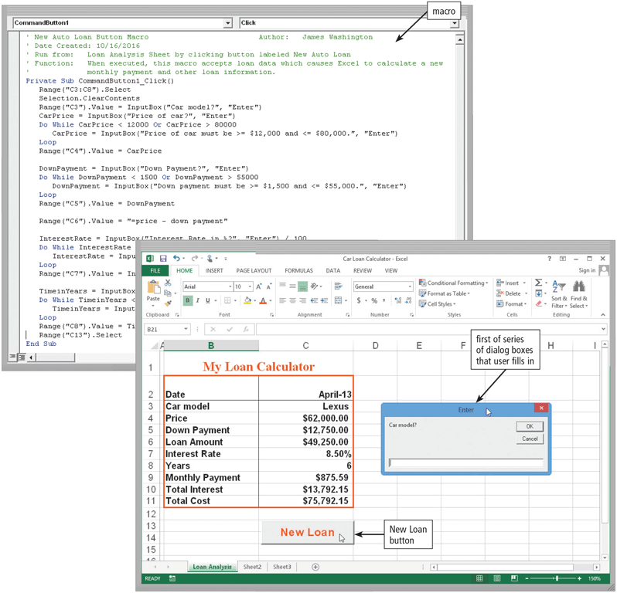
Application Development Languages and Tools
Page 533
Figure 11-22

Slide 60
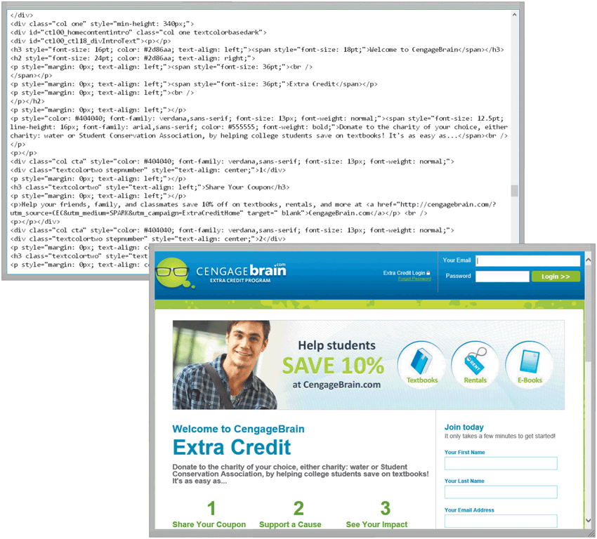
Application Development Languages and Tools
HTML is a special formatting language that software developers use to format documents for display on the web
Page 535
Figure 11-23

Slide 61
Application Development Languages and Tools
XML allows web developers to create tags that describe the structure of information
WML is a subset of XML and is used to design pages specifically for microbrowsers
Page 536

Slide 62
Application Development Languages and Tools
Software developers write scripts, applets, servlets, or ActiveX controls using a variety of languages
JavaScript
Perl
PHP
Python
Ruby
Page 536

Slide 63
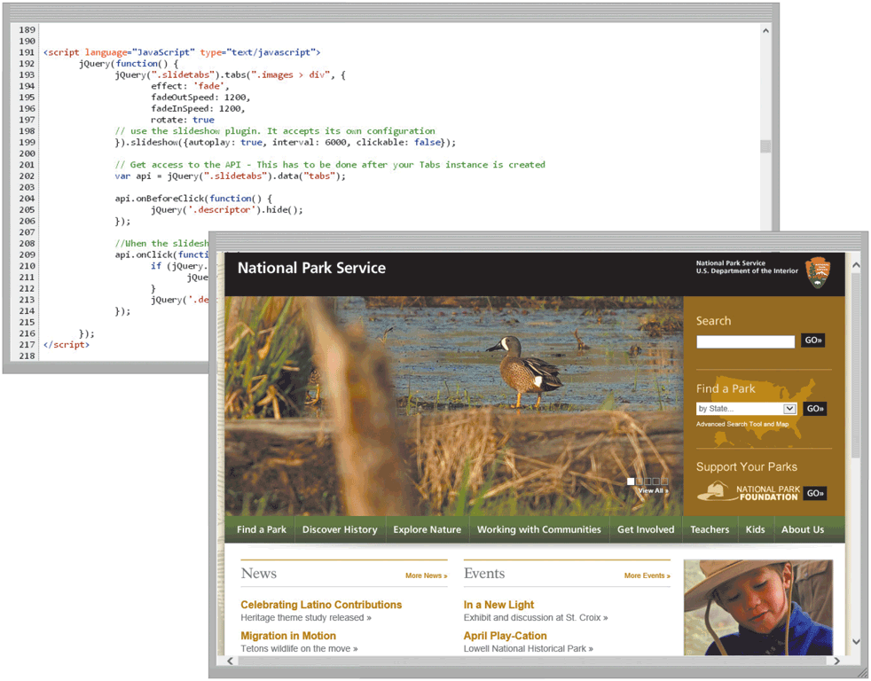
Application Development Languages and Tools
Page 537
Figure 11-24

Slide 64
Summary
Hierarchy of data, ways to validate data, the advantages of the database versus the file processing approach, and characteristics of database management systems
System development phases and the guidelines for system development, along with activities that occur during system development
Various programming languages and application development tools
Variety of web development tools
Page 539

Slide 65
Chapter 11 Complete

